Slide 1
ENGI 301 Sound-Reactive LED Lights PCB Proposal
November 26, 2019
Juliana Wang

Slide 2
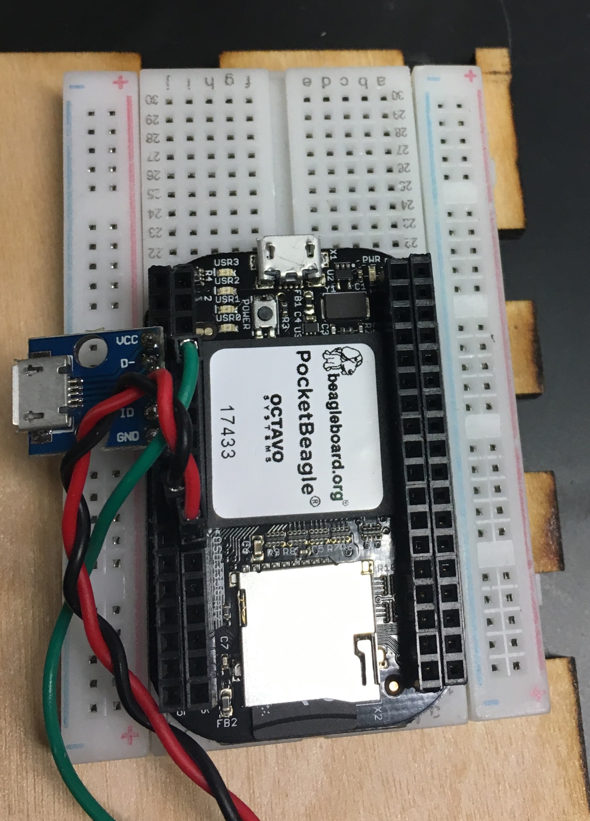
Background Information
Pocketbeagle connects to LED light strip that reacts to a wav file, recorded from an AUX cord
Functionality:
Audio adapter for audio input (AUX cord) and output (speaker)
LED strip connections (+5V V_OUT, GND, GPIO for data)
MicroUSB port for Pocketbeagle power/computer connection
Chip for processing
MicroSD port

Slide 3
System Block Diagram
PocketBeagle
MicroUSB Host Connector
USB1.VIN
P1.24 SYS VOUT
+5V
LED Light Strip
USB Adapter
P1.05 VBUS, P1.07 VIN
P1.09 DN
P1.08 GPIO 2 SPI0 CLK
Data_IN
P1.11 DP
GND
P1.13 ID, P1.15 GND
P1.22 SYS GND

Slide 4
Mechanical Block Diagram
Pocketbeagle
35mm x 56mm
USB port
12mm x 14mm
51mm
(~2 in)
Audio Adapter
28mm x 29mm
3-Wire Ribbon Snap Connector
WS2812B Compatible
(V_OUT, GND, and GPIO)
12mm x 14mm (estimated)
89mm
(~3.5 in)

